Slide 1


Josué Montila.
08/07/2025

Slide 2

Outline
Executive Summary
Introduction
Methodology
Results
Conclusion
Appendix

Slide 3
Executive Summary
In this capstone project, our objective is to develop a predictive model that can determine whether the SpaceX Falcon 9 first stage will successfully land or not, based on various factors related to the rocket's first stage.
We begin with data collection, cleaning, and exploratory data analysis (EDA) using SQL queries and data visualizations.
We also visualize the launch sites on an interactive map using Folium, and create an interactive dashboard for data visualization using Plotly and Dash.
Through graphical analysis, we observe that certain rocket features show strong relationships with the success or failure of the landing.
Multiple machine learning models are developed and evaluated to identify the one that most accurately predicts the landing outcome—whether it's a success or failure.

Slide 4
Introduction
SpaceX promotes the Falcon 9 rocket launches on its official website at a cost of $62 million per launch, whereas competitors often charge over $165 million. A significant portion of this cost efficiency comes from SpaceX's ability to reuse the rocket’s first stage. As a result, being able to predict the success of the first stage landing can help estimate the overall launch cost. This insight can be valuable for other companies aiming to compete with SpaceX in the launch services market.
The primary focus of our project is to determine whether the Falcon 9's first stage lands successfully or not.
We are conducting a detailed data analysis to gather relevant and reliable data that will be used to predict the success of Falcon 9 landings.
Our approach involves developing a machine learning classification model that examines various features and predicts the likelihood of a successful Falcon 9 first stage landing.

Slide 5

Section 1

Slide 6
Methodology
Data Collection Approach:
The data for this project is obtained through two primary methods: accessing the SpaceX API and web scraping data from Wikipedia.
SpaceX offers several APIs that return JSON-formatted data, providing up-to-date details on their space missions and operations.
Additionally, Wikipedia hosts comprehensive information on various space missions, which can be extracted through web scraping techniques to meet our data needs.

Slide 7
Methodology (cont..)
Data Wrangling Process:
The raw dataset contains missing entries, irrelevant values, and inconsistent data types.
To clean the data, we either replace missing values with suitable alternatives or eliminate them, depending on the context and relevance.

Slide 8
Data Collection
Data collection is the initial and crucial phase of any data analysis process.
In this project, we are gathering information related to Falcon 9 first stage landings using two main sources:
SpaceX APIs, and
Web scraping from Wikipedia.
SpaceX provides public APIs on its website that allow us to retrieve up-to-date data about rocket launches and various space missions.
Wikipedia contains detailed and reliable records of space missions, making it a valuable source for scraping relevant data.

Slide 9
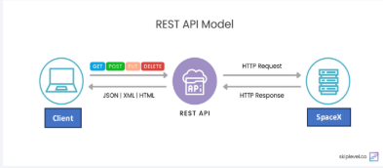
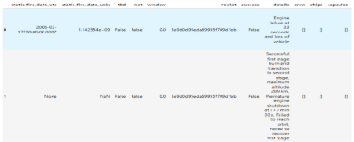
Data Collection – SpaceX API
We utilized the requests library in Python to send a GET request to the SpaceX API.
The API responded with a 200 status code, indicating success, and returned the data in JSON format.
This JSON data was then processed and normalized using Pandas, and transformed into a DataFrame for further analysis.
The completed notebook for the SpaceX API data extraction is available on GitHub at:GitHub URL goes here)

Slide 10
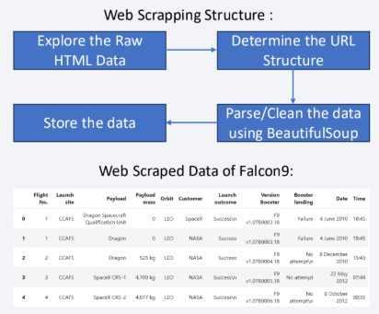
Data Collection - Scraping
We began by sending a requests.get() call to the webpage URL to retrieve its content.
The website responded with the HTML content, which we read as plain text.
We then used BeautifulSoup to parse and structure the HTML, allowing us to extract the required data in an organized manner.
The full notebook for the web scraping process is available on GitHub at: GitHub URL goes here)

Slide 11
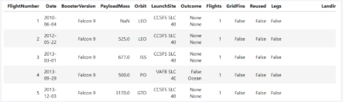
Data Wrangling
The API data included both Falcon 1 and Falcon 9 launches, so we filtered out Falcon 1 entries.
We found missing values: 5 for Payload Mass and 26 for Landing Pad. Rows with missing Payload Mass were removed.
Flight numbers were reset starting from 1.
A new "Class" column was created: 1 for successful landings, 0 for failures, based on the "Outcome" column.
GitHub URL of the data wrangling notebook: Your URL here
The final DataFrame consists of 90 rows and 17 columns. The columns include: FlightNumber, Date, BoosterVersion, PayloadMass, Orbit, LaunchSite, Outcome, Flights, GridFins, Reused, Legs, LandingPad, Block, ReusedCount, Serial, Longitude, and Latitude.

Slide 12
EDA with Data Visualization
During Exploratory Data Analysis (EDA) with visualizations, we explored relationships between various features in the dataset.
We used scatter plots and bar/line charts to identify potential correlations influencing launch outcomes.
Scatter plots were used to analyze how launch success is affected by combinations of:
Flight Number vs. Payload Mass
Flight Number vs. Launch Site
Payload Mass vs. Launch Site
Flight Number vs. Orbit Type
Payload Mass vs. Orbit Type

Slide 13
EDA with Data Visualization (cont…)
We also used:
A bar chart to visualize success rate by Orbit Type
A line chart to observe success rate by Year
GitHub URL for the completed EDA and visualization notebook:URL

Slide 14
EDA with SQL
Data analysis was performed using SQL queries to identify patterns and insights.
Data was stored in a SQLite3 database, and queries were executed using connection and cursor objects.
We analyzed the maximum Payload Mass across different booster versions and customers.
Mission outcomes were grouped to count successes and failures, and trends were explored over time and across payload mass ranges.
The date of the first successful landing was also identified.
GitHub URL for the completed SQL analysis notebook:URL

Slide 15
Build an Interactive Map with Folium
This part of the project focused on three key tasks:
Plotting all launch sites on a map
Marking successful and failed launches at each sit
Calculating distances from launch sites to nearby points of interest
The map was built using folium.Map() with defined coordinates and zoom level.
We added elements like circles and popups for each launch site using .add_child().
Marker Clusters were used to display launch outcomes (success/failure).
Distance markers and connecting lines were added to show proximity to nearby features.
GitHub URL of completed interactive map with Folium map: [Insert URL]

Slide 16
Build a Dashboard with Plotly Dash
We developed a dashboard to visually present SpaceX launch data analytics.
A dropdown menu allows selection of all launch sites or a specific site.
Based on the selection, a pie chart displays the success rate for all or selected sites.
A range slider lets users filter by Payload Mass.
Using the selected site(s) and payload range, a scatter plot shows Payload Mass vs. Class across Booster Versions.
The dashboard layout includes a heading followed by four components: Dropdown, Pie Chart, Range Slider, and Scatter Plot.
GitHub URL for the completed dashboard: URL

Slide 17
Predictive Analysis (Classification)
We built four classification models to predict Falcon 9 landing outcomes as Success (1) or Failure (0) using various features:
Logistic Regression
Support Vector Machine (SVM)
Decision Tree
K-Nearest Neighbors (KNN)
The data was first scaled using StandardScaler, then split into training and testing sets (80/20).
GridSearchCV was used to tune hyperparameters for each model.
Finally, we compared model performance using the confusion matrix and accuracy score on the test set.
GitHub URL for the completed machine learning analysis: URL

Slide 18
Results
Exploratory Data Analysis (EDA) Results:
The first successful landing occurred on 2015-12-22.
Boosters that successfully landed on a drone ship with payloads between 4000–6000 kg include:
F9 FT B1022, B1026, B1021.2, and B1031.2.
The F9 B5 booster series carried the maximum payload mass overall.
The average payload mass for the F9 v1.1 booster is approximately 2535 kg.

Slide 19
Results
Predictive Analysis Results:
All models achieved a test accuracy of 83.33%, with similar recall, precision, and true positive rate.
The Decision Tree Classifier showed the highest training accuracy (88.75%), possibly due to overfitting, while others averaged around 85%.
Since the train-test accuracy gap is small, the Decision Tree may still be the most suitable model for classification.

Slide 20
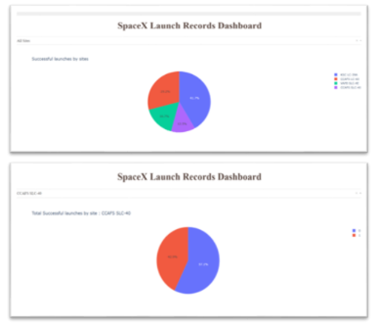
Results
•Interactive analytics demo :

Slide 21

Section 2

Slide 22
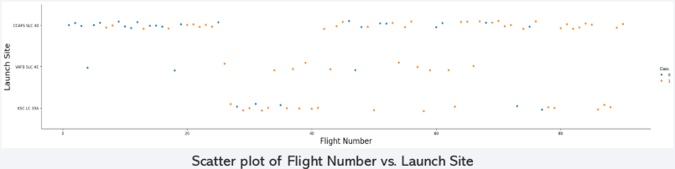
Flight Number vs. Launch Site
At each launch site, a higher Flight Number generally indicates a greater chance of a successful landing.
VAFB SLC 4E shows a high success rate even with fewer launches compared to other sites.

Slide 23
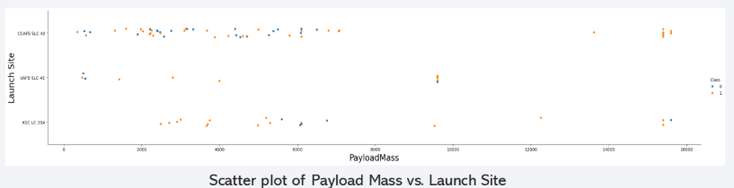
Payload vs. Launch Site
At CCAFS SLC 40, a higher Payload Mass tends to increase the chances of a successful landing.
However, at VAFB SLC 4E and KSC LC 39A, there is no clear correlation between Payload Mass and landing outcome.

Slide 24
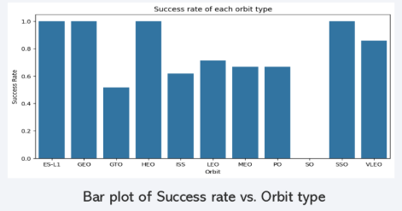
Success Rate vs. Orbit Type
Flights to ESL1, GEO, HEO, and SSO orbits have shown a 100% success rate in Falcon 9 first-stage landings, whereas flights to SO orbit have had no successful landings.
Other orbits show a landing success rate of 50% or higher.

Slide 25
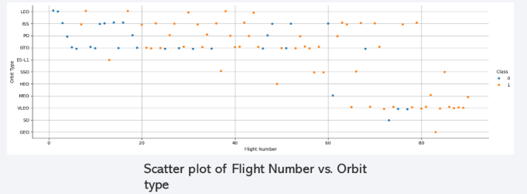
Flight Number vs. Orbit Type
Flights to LEO, VLEO, and MEO orbits show a correlation between the number of flights and successful first-stage landings of Falcon 9.
In contrast, flights to other orbits show little to no correlation between flight count and landing success.

Slide 26
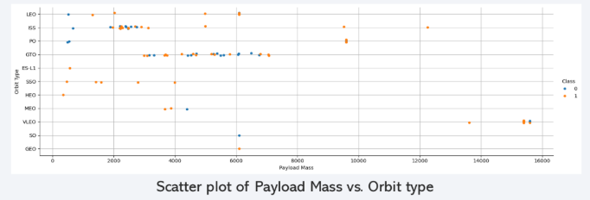
Payload vs. Orbit Type
Flights to LEO, ISS, and PO orbits show that higher Payload Mass is associated with increased success in first-stage landings.
Flights to other orbits do not display a clear relationship between Payload Mass and landing success.

Slide 27
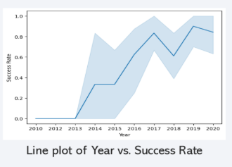
Launch Success Yearly Trend
The graph indicates a steady rise in success rate starting from 2013.
There is a slight dip in success rate between 2017 and 2018.
After 2018, the success rate increases again, continuing up to 2020.

Slide 28
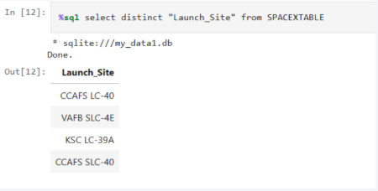
All Launch Site Names
• We used Distinct method to find unique Launch Site names from a
SPACEXTABLE table using SQL query as :
%sql select distinct "Launch_Site" from SPACEXTABLE

Slide 29
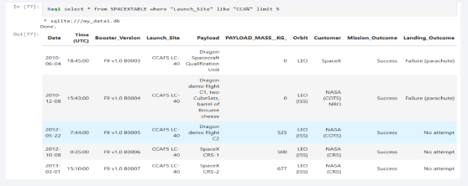
Launch Site Names Begin with 'CCA'
Launch Sites with names begin “CCA” are queried using “like” clause on launch site column by passing value as “CCA%”.
•Limit 5 clause is used to get only 5 records.
%sql select * from SPACEXTABLE where "Launch_Site" like "CCA%" limit 5

Slide 30
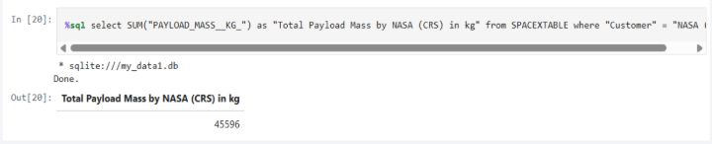
Total Payload Mass
The total payload mass for the customer "NASA (CRS)" was calculated using the SUM() function on the "Payload_Mass__kg_" column with a WHERE clause to filter by customer.
The total payload mass for NASA (CRS) amounts to 45,596 kg.%sql select SUM("PAYLOAD_MASS__KG_") as "Total Payload Mass by NASA (CRS) in kg" from
SPACEXTABLE where "Customer" = "NASA (CRS)"

Slide 31
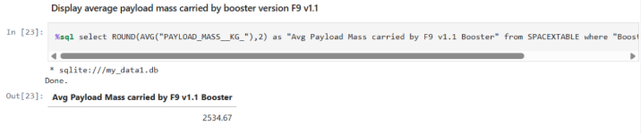
Average Payload Mass by F9 v1.1
The average payload mass for boosters starting with F9 v1.1 is 2535 kg.
This was calculated using the AVG() function.
A WHERE clause with a LIKE condition was used to filter booster versions that begin with "F9 v1.1".
%sql select ROUND(AVG("PAYLOAD_MASS__KG_"),2) as "Avg Payload Mass carried by F9 v1.1
Booster" from SPACEXTABLE where "Booster_Version" like "F9 v1.1%“

Slide 32
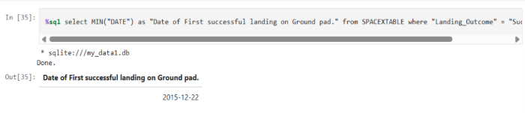
First Successful Ground Landing Date
The first successful ground landing occurred on December 22, 2015.
The MIN() function was used to identify the earliest landing date.
A WHERE clause filtered the data to include only landings with the outcome "Success (ground pad)".
%sql select MIN("DATE") as "Date of First successful landing on Ground pad." from
SPACEXTABLE where "Landing_Outcome" = "Success (ground pad)“.

Slide 33
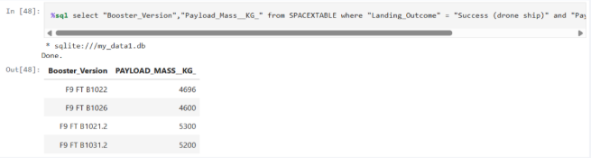
Successful Drone Ship Landing with Payload between 4000 and 6000
Successful Drone Ship Landings with Payload between 4000 and 6000 are : F9 FT
B1022 , F9 FT B1036 , F9 FT B1021.2 , F9 FT B1031.2 .
WHERE clause is used with and clause to select the Landing Outcome as “Success
(drone ship)” and Payload Range as 4000 to 6000 kg. For Range “between .. and ..”
clause is used.
%sql select "Booster_Version","Payload_Mass__KG_" from SPACEXTABLE where "Landing_Outcome" = "Success (drone
ship)" and "Payload_mass__Kg_" between 4000 and 6000

Slide 34
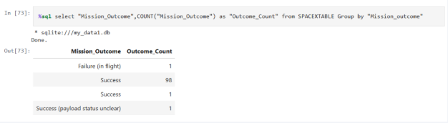
Total Number of Successful and Failure Mission Outcomes
There are total 100 successful missions and 1 Failure in flight mission
outcomes in data.
Group by clause is used to group “Mission Outcome” and COUNT() method is
used to get count of Outcomes.
%sql select "Mission_Outcome",COUNT("Mission_Outcome") as "Outcome_Count" from SPACEXTABLE Group by "Mission_outcome"

Slide 35
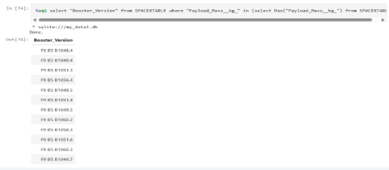
Boosters Carried Maximum Payload
The boosters that carried the maximum payload belong to the F9 B5 series.
A subquery was used to find the maximum value in the "Payload_Mass_kg_" column.
The corresponding "Booster_Version" values were then selected to identify the specific boosters.
%sql select "Booster_Version" from SPACEXTABLE where "Payload_Mass__kg_" in (select Max("Payload_Mass__kg_") from SPACEXTABLE)

Slide 36
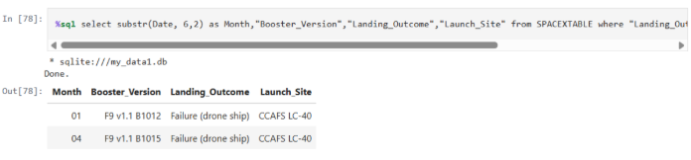
2015 Launch Records
We used the substr() function to extract the month from the Date column and applied a LIKE clause to filter records from the year 2015.
A WHERE clause was used to select rows where the Landing Outcome was "Failure (drone ship)".
%sql select substr(Date, 6,2) as Month,"Booster_Version","Landing_Outcome","Launch_Site" from
SPACEXTABLE where "Landing_Outcome"="Failure (drone ship)" and Date like "2015%"

Slide 37
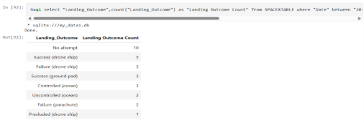
Rank Landing Outcomes Between 2010-06-04 and 2017-03-20
The date range was filtered between 2010-06-04 and 2017-03-20 using a WHERE clause.
Landing outcomes were grouped using the GROUP BY clause, and the COUNT() function was used to count each outcome type.
An ORDER BY clause with DESC was applied to sort the outcomes in descending order by count.
%sql select "Landing_Outcome",count("Landing_Outcome") as "Landing Outcome Count" from SPACEXTABLE where "Date“ between "2010-06-04" and "2017-03-20" group by "Landing_Outcome" order by count("Landing_Outcome") desc

Slide 38

Section 3

Slide 39
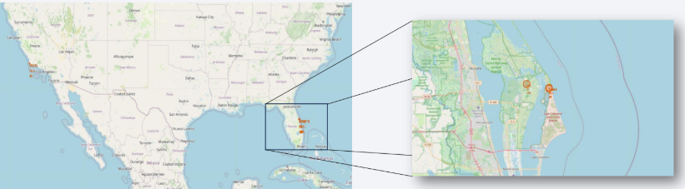
Locations of all Launch Sites on World Map
There are four launch sites in total — three located on the U.S. East Coast and one on the West Coast.
A 1 km radius circle was drawn around each launch site, along with a marker displaying the site name in a popup.

Slide 40
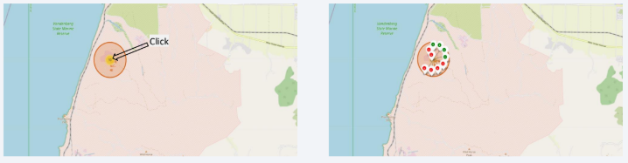
Success and Failed Launches for each site on Map
Green markers represent successful launches, while red markers indicate failures, and are placed on the map for each launch site.
A Marker Cluster is used to group markers that are located at the same or nearby positions.
Clicking on a cluster reveals the individual success (green) and failure (red) icons.

Slide 41
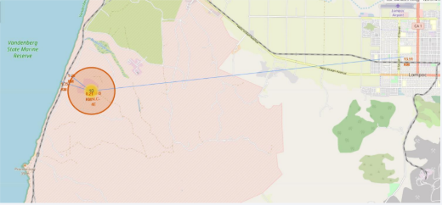
Mapping proximities from Launch Sites
Distances to the nearest features—such as the coastline, railway, highway, and city—were calculated using their coordinates and those of the launch sites.
A distance marker was placed at each point to display the distance from the launch site.
Lines were drawn to visually connect each launch site with its corresponding nearby location.
Distance from Launch Site:
• Coast line : 1.35 km
• Railway line : 1.25 km
• Highway road : 0.21 km
• City : 13.51 km

Slide 42

Section 4

Slide 43
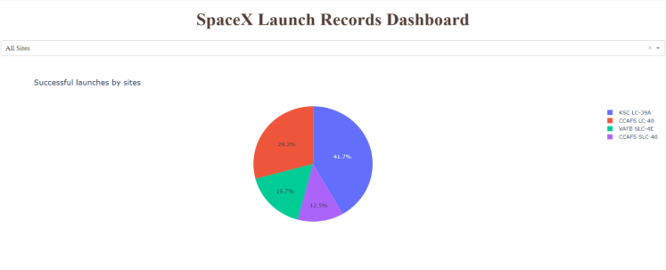
Pie Chart of Launch Success Count for All Sites
KSC LC -39A Launch Site has most successful Launches while CCAFS SLC-40 has least successful launches of Falcon9.

Slide 44
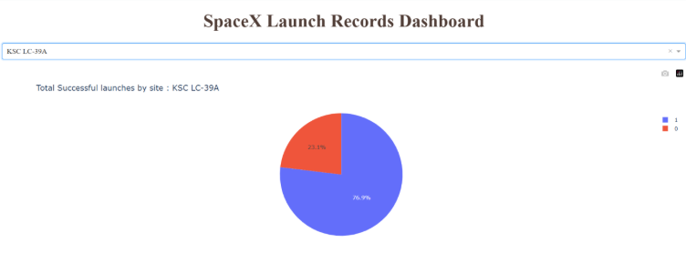
Pie Chart of Lauch Site with Highest Lauch Success Rate
KSC LC-39A has highest launch success rate with 76.9% of Success in Launching flights.

Slide 45
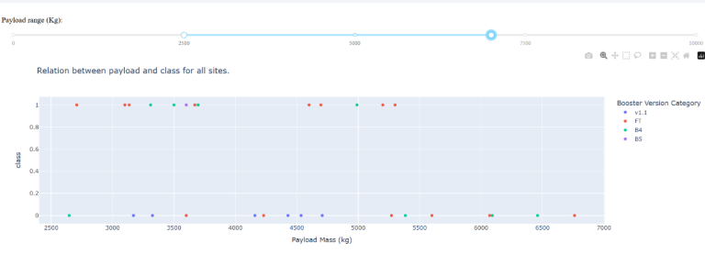
Scatter Plot of Success rate in Payload Mass range 2500kg to 7000kg
No clear correlation is observed between Payload Mass and Success Rate within the 2500 to 7000 kg range.

Slide 46

Section 5

Slide 47
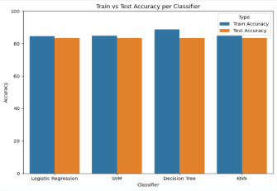
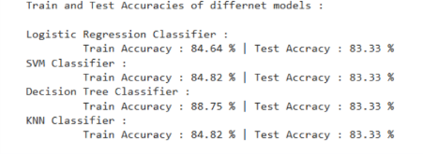
Classification Accuracy
All four classification models achieved the same test accuracy of 83.33%.
The Decision Tree Classifier showed the highest training accuracy at 88.75%, possibly due to overfitting, while the other models had training accuracies around 85%.
Since the difference between training and test accuracy is minimal, the Decision Tree Classifier may be the best choice for classification.

Slide 48
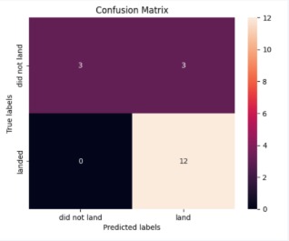
Confusion Matrix
The Decision Tree Classifier is the best model for predicting Falcon 9 first-stage landings.
Although it has 3 false positives, which is not ideal, it still performs better than the other models.
The model achieves a 100% true positive rate, with a recall of 100% and precision of 80% for successful landing predictions.
It also has the highest training accuracy at 88.75% and a test accuracy of 83.33%.

Slide 49
Conclusions
This project aims to predict whether the first stage of a Falcon 9 launch will land successfully, helping to estimate the launch cost.
Various features of a Falcon 9 launch, such as payload mass and orbit type, may influence the mission outcome.
Multiple machine learning algorithms were used to analyze historical Falcon 9 launch data and build predictive models.
Among the four algorithms tested, the decision tree model showed the best performance in predicting launch outcomes.

Slide 50
Appendix
L1_SpaceX_Data_Collection_using_API.ipynb
L2_SpaceX_Data_Collection_using_W
L3_SpaceX_Data_Wrangling.ipynb
L4_SpaceX_EDA_with_SQL_(sqlite3).ipynb
L5_SpaceX_EDA_with_Visualization.ip
L6_SpaceX_Visual_Analytics_with_F
L7_SpaceX_App_Dashboard_using_
L8_SpaceX_Prediction_Analysis_(ML

Slide 51


